Slide 1
Uber Scaling Operations and Data Analytics
COMP-5012-FA - Big Data
Sansarmaa Gantumur 1313249
Bogdan Parvu 1299622
Yingda Zhang 1311471
Alan Zhong 1312041
October 20, 2025

Slide 2
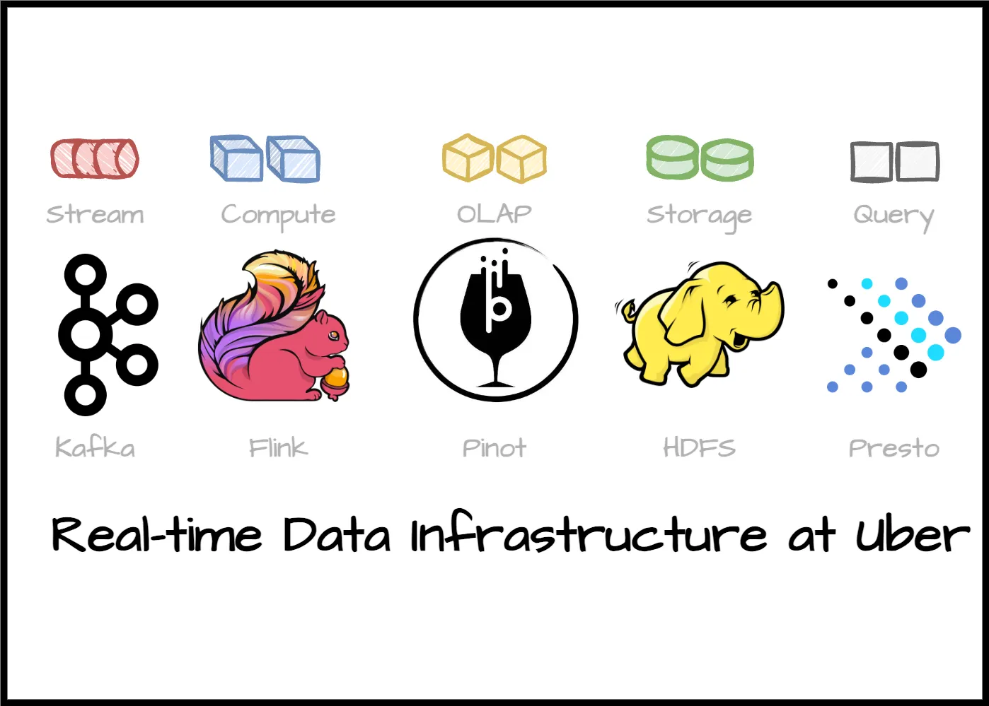
Technical Overview
Why Real-Time Data Matters for Uber?
business is deeply real-time in nature
trillions of messages per day, on the order of petabytes of data
Kafka clusters using Kappa architecture
500,000+ Presto SQL queries daily
batches / historical layer with HDFS and Cloud Storage
Constraints:
Data Freshness / Low Latency
High Availability & Fault Tolerance
Scalability
Correctness / Exactly-Once Semantics
Cost Efficiency
Consistency between Streaming and Batch Views

Slide 3
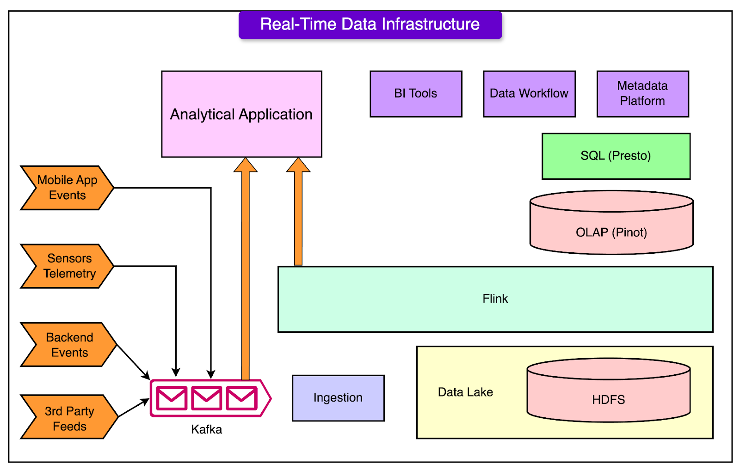
Core Architecture
Event Ingestion / Messaging
Stream Processing / Real-Time Computations -
Serving / OLAP / Low-Latency Query Layer
Batch Processing / ETL / Data Lake
Governance, Observability & Platform Infrastructure

Slide 4
Uber’s Big Data Platform - Kafka to Presto
Layer | Key Components | Purpose
Data Ingestion | Data Sources, Kafka, uReplicator | Real-time event streaming and replication
Data Lake & Storage | HDFS, Gobblin, Apache Hudi | Transactional storage and ingestion
Processing & Compute | Kappa+ Architecture, Flink, Marmaray | Unified stream + batch compute and replay
Analytics & Query | AthenaX, Pinot, Presto | Real-time analytics and distributed querying
Governance | Schema Registry, Metadata Store | Schema evolution, lineage, and governance

Slide 5
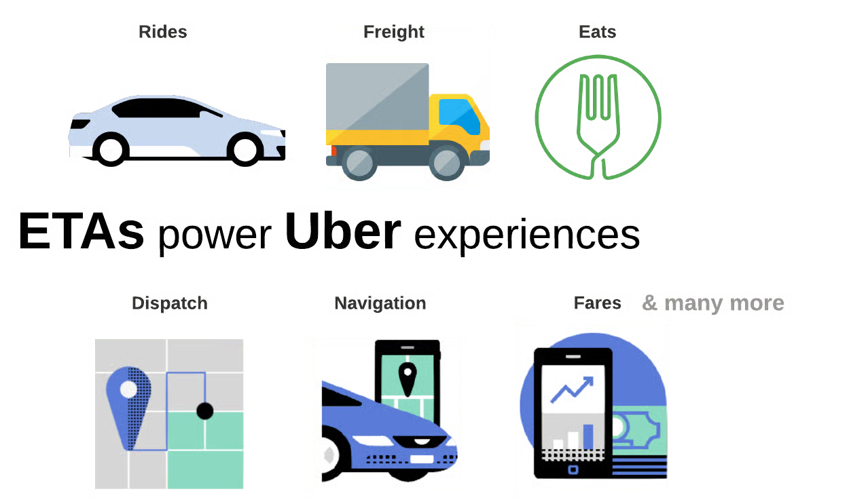
Challenges: Latency and Throughput
Real-time operations (ride matching, pricing) require millisecond level latency.
Higher data throughput increases batch volume but can cause processing delays.
Trade-off: The faster you process the more compute resources you consume.
Solution: Apache Kafka /high throughput message streaming/
Apache Flink /adaptive stream processing that scales up automatically/

Slide 6
Challenges: Consistency Between Streaming & Batch Views
Uber processes data in two modes real-time (Kafka/Flink) and batch (HDFS/Spark).
Real-time streams give instant metrics batch ensures full accuracy and completeness.
Trade off: Speed and Full accurate result
Solution: Uber implements a Kappa+ architecture combining both layers for consistent analytics.
Reduces the reconciliation delay between fast and accurate data views.

Slide 7
Challenges: Cost & Resource Utilization
Uber maintains thousands of distributed servers for Michelangelo platform and real time analytics,
Over-provisioning wastes resources Under-provisioning causes data lag or system failure.
Trade-off: Cost control and system reliability.
Solution: Dynamic scheduling and auto-scaling on Kubernetes and Mesos for optimal resource use.
Automatically adds or removes compute resources based on real time load.

Slide 8
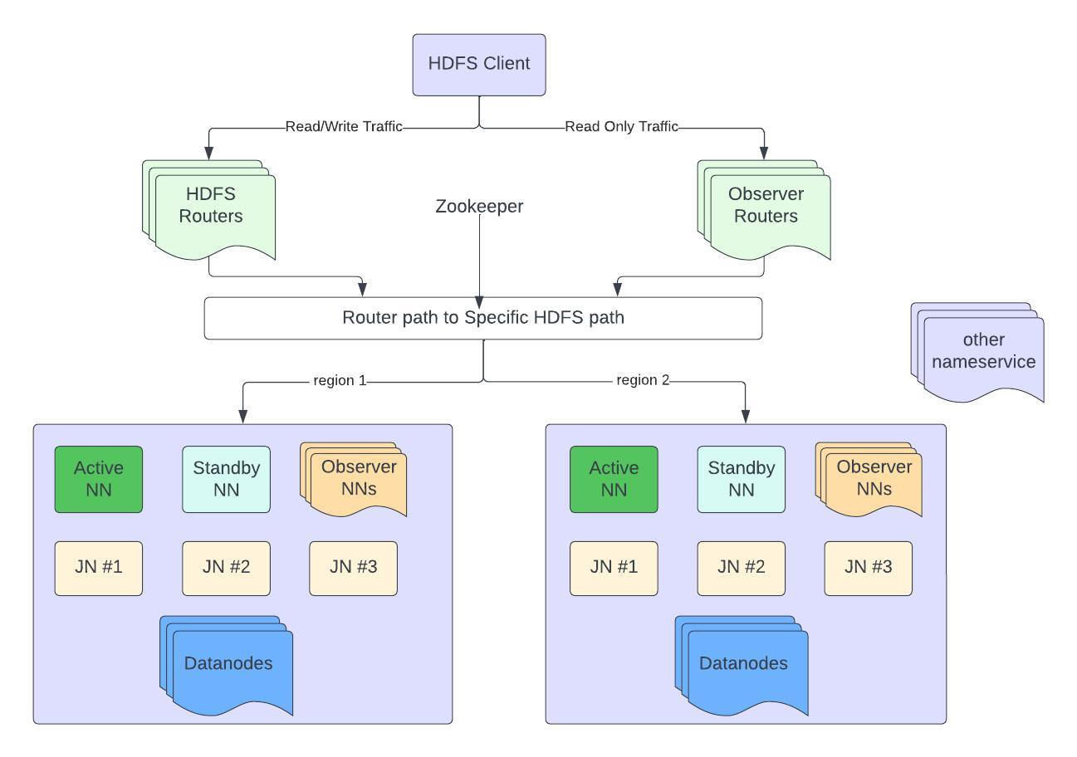
Uber DataLake: HDFS for Storage
Uber uses Apache Hadoop Distributed File System to store a large amount of data (exabytes of data across tens of clusters)
Client requests to write, and the NameNode will assign data blocks for storage
Later on, YARN (Yet Another Resource Negotiator) schedules a computational task requires the data stored by the client
For locality, YARN chooses the nodes that are closed to the data stored
Problems occur!

Slide 9
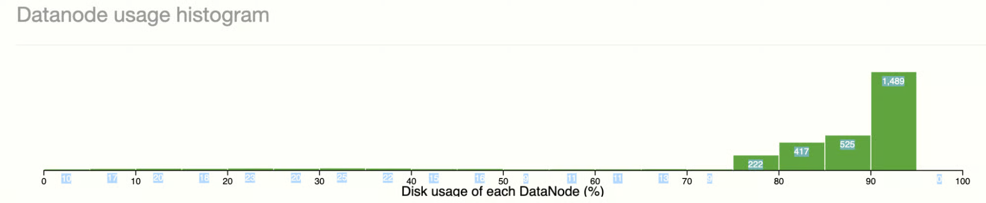
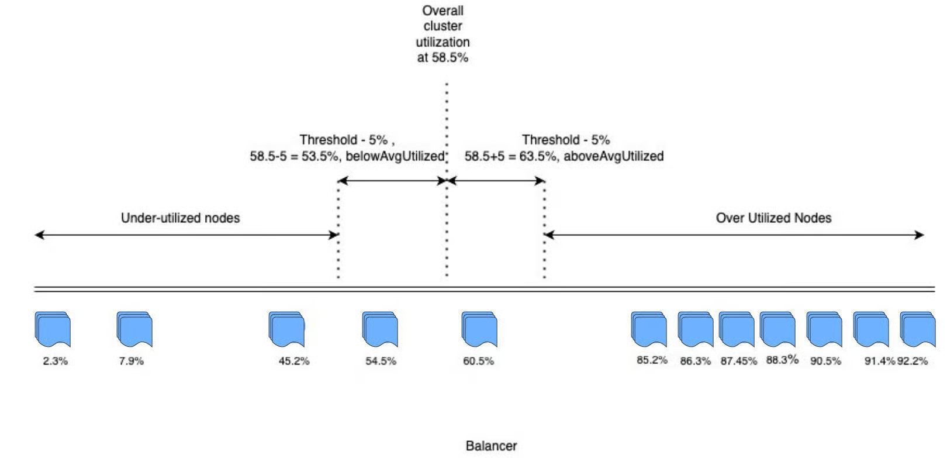
Uber DataLake: Problems
Large amount of similar operations (in the similar categories) overwhelms a small sets of data nodes
High/Over utilizations occurs
We need a balancer to solve this issue
HDFS built-in balancer does not work well in this scenario due to:
  Simple average
  Slow
  Cross-rack movement reduces the overall efficiency significantly
Uber designed its own solutions!

Slide 10
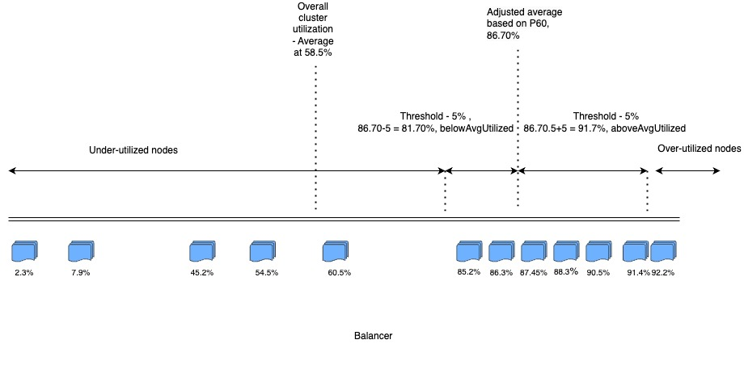
Uber DataLake: In-house solutions
Percentile-based balancing algorithm
  Only balance the sets of highest utilized nodes (source nodes)
  Only choose the sets of least utilized nodes as the destination nodes
  After balancing, the:
    Utilization difference < threshold
Rack-awareness Data Movement: Prefer intra-rack balancing first
Increase pairs for concurrency, while limiting the data movement for extreme high I/O utilization nodes to preserve the efficiency of HDFS

Slide 11
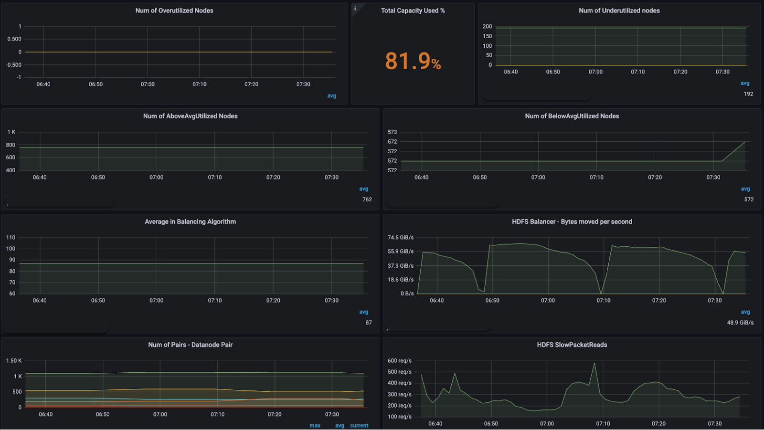
Uber DataLake: Conclusions
Apache Hadoop Distributed File System allows faster and more efficient data distributive storage and computations
However, it faces issues such as:
  Over utilization
  Cross rack data movement
  Original HDFS balancer doesn’t work well
In-house solutions such as:
  Percentile based balancing algorithm
  Rack-awareness data movement
  Some new monitoring tools
The problems are not bugs, it is due to the nature of the HDFS.

Slide 12
Lessons Learned
Off-the-shelf systems can’t handle enterprise scale data workloads.
→ Uber built custom internal tools to overcome scalability limits.
Data hotspots severely affect performance.
→ Dynamic percentile based balancing ensures even resource use.
Physical data location matters (rack awareness).
→ Reduces network latency and improves throughput.
Custom-built infrastructure becomes a long-term advantage.
→ Internal tools like Michelangelo, H3, and Uber’s custom HDFS extensions give Uber a competitive edge.

Slide 13
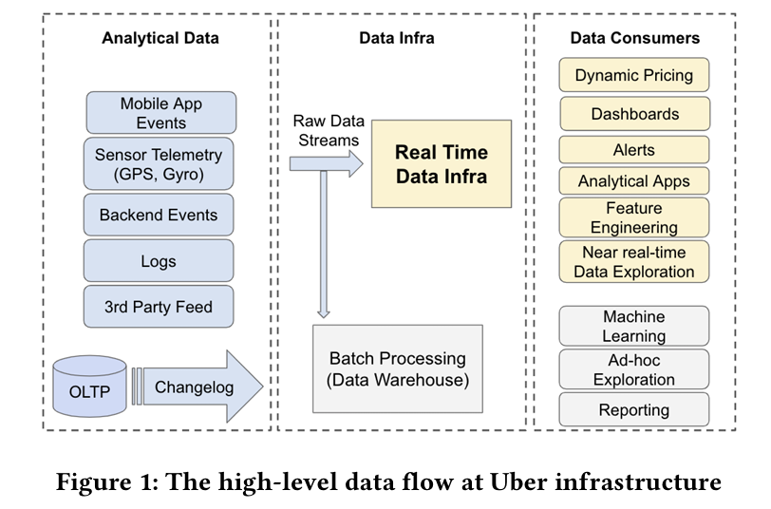
Best Practices
Real-time data flow:
Analytical data continuously collected by Kafka:
Massive volumes , continuous, various kinds (Structured Data, Semi-Structured Data,Unstructured Data)
Data infra:
Store and compute data to be ready for implementing dynamic pricing, intelligent alerting, operational dashboards and more
Data consumers:
Systems, applications, and analytical tools that rely on data from data Infra

Slide 14
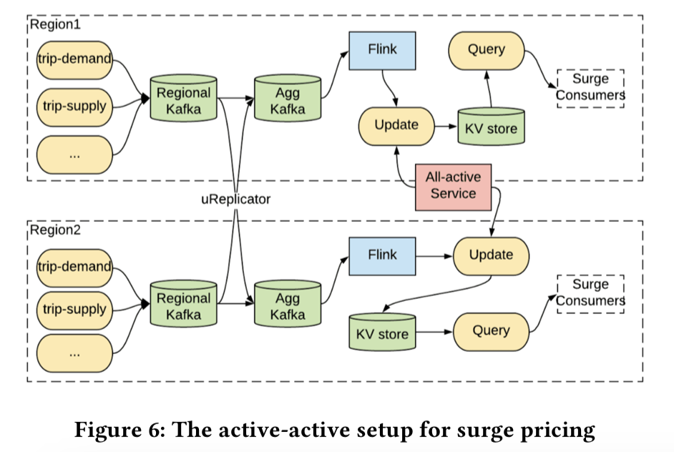
Use Cases and Examples
Surge Pricing :
Dynamic pricing mechanism to balance the supply of available drivers with the demand for rides.
According to streaming data(including travel data, passenger and driver status, etc ) from Kafka, the surge pricing pipeline runs machine-learning to compute surge price and store the result in a sink with key-value
Multi-region strategy ensures disaster recovery
Kafka regional cluster (also as an aggregate for the global view by uReplicator) -> Flink (compute) -> update service(store pricing result)->KV store ( store data with key-value )
When disaster strikes the primary region, the Kafka active-active service assigns another region to be the primary

Slide 15
Summary & Takeaways
Uber's real-time data infrastructure and its design principles
Introduce real-time data infrastructure core Architecture
DataLake : HDFS, its issues and solutions
Challenges and solutions:
  Apache Kafka for streaming storage : Scalability
  Apache Flink for stream processing : Scalability, failure recovery
Dataflow: Massive data processing procedure
Use cases introduction

Slide 16


Slide 17
References
[1] Yupeng Fu, Chinmay Soman (2021, June 25). Real-time Data Infrastructure at Uber. English.
https://dl.acm.org/doi/pdf/10.1145/3448016.3457552
[2] Reza Reza (2018, October 17). Uber’s Big Data Platform: 100+ Petabytes with Minute Latency. https://www.uber.com/en-CA/blog/uber-big-data-platform/
[3] Atul Kaushik, Yangjun Zhang (2024, March 14). Balancing HDFS DataNodes in the Uber DataLake. https://uber.com/en-CA/blog/balancing-hdfs-datanodes-in-the-uber-datalake/
[4] Uber Tech Blog (2023–2025), “Michelangelo ML Platform and Real-Time Data Scaling.
https://www.uber.com/en-CA/blog/michelangelo-machine-learning-platform

